Slide 1
Smart Space
Yash Narayan
T V Tharun
Sasank
AV.SC.U4CSE24349
AV.SC.U4CSE24328
AV.SC.U4CSE24246

Slide 2

INTRODUCTION
WHY SMART SPACE ?
CORE TOOLS & FEATURES
Overview of Smart Space and its purpose
Addressing student academic challenges
Key tools included in Our platform
SYSTEM DESIGN
FUTURE SCOPE
ADVANTAGES & TUTORIAL
E-R Diagram and Data flow
Future Features planning for Smart Space
Benefits of Smart Space and Tutorial

Slide 3
INTRODUCTION

Slide 4
Introduction – Overview of Smart Space and its purpose
Smart Space is a student-centric web tool that personalizes the access to academic like routines, study materials, and performance tools.
It simplifies student academic life by bringing all tools to one accessible platform.

Slide 5
WHY SMART SPACE ?

Slide 6
PROBLEMS IDENTIFIED
1. Attendance Crisis
Nearly 50% of students in each section struggle to maintain the minimum 75% attendance at least in 1 subject, risking detention or exam ineligibility due to poor tracking and planning.
2. Academic Imbalance
Many students experience low academic performance because they lack a clear understanding of how to distribute study time across subjects, leading to unbalanced preparation and burnout.

Slide 7
PROBLEMS IDENTIFIED
3. Scattered Academic Resources
There is no centralized platform in the college where students can reliably access essential materials like previous year questions, textbooks, and faculty-recommended resources — resulting in wasted time and missed opportunities to prepare better.
4. Uninformed Meal Choices
A surprising number of students are skipping meals or ordering junk food, simply because they don’t know what’s being served in the mess today — a small yet impactful issue affecting student health and finances.

Slide 8


Overview of Core Tools & Features

Slide 9




KEY TOOLS OF OUR PLATFORM
Attendance Predictor
CAMPUS COMPASS
CGPA Calculator
RESOURSES
CAMPUS COMPASS
This tool predicts your final attendance if you miss future classes.
Students can input their current semester scores and instantly calculate their CGPA.
A collaborative tool to share notes and download resources.
A tool that predicts likely mess menus to help students to plan their meals.

Slide 10

E-R Diagram
Understanding System Data relationship

Slide 11
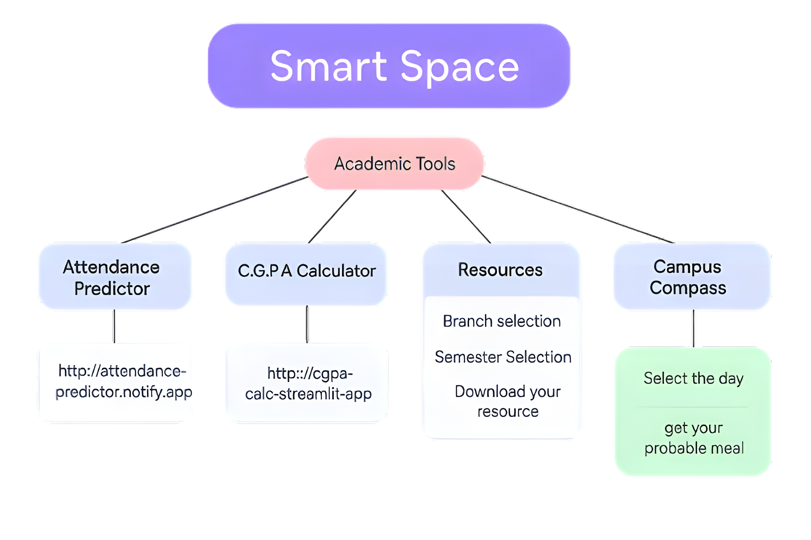

Slide 12
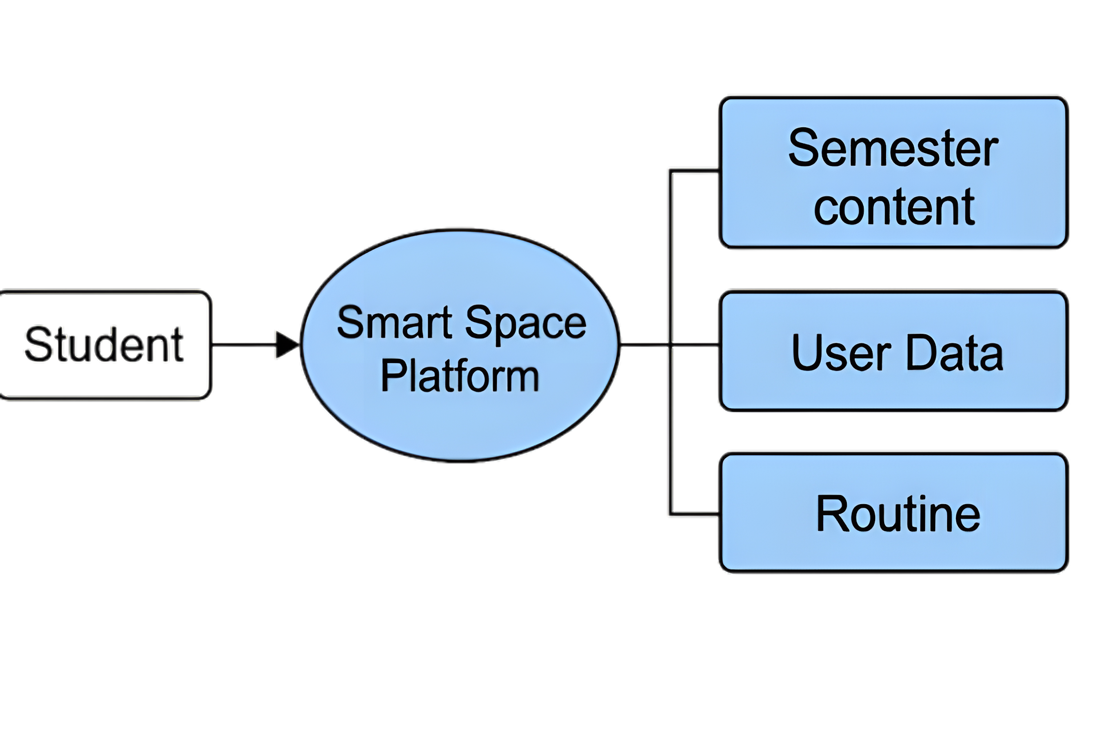
Data flow diagram

Slide 13
Future Scope
Expanding features for Smarter Academic Management

Slide 14
01
02
Custom-Built Tools Integration
Add in-house Attendance Predictor & CGPA Calculator for smoother, faster performance.
Student Login & Dashboard
Personalized accounts to save attendance, CGPA progress, routines & more.

Slide 15
03
04
Student Resource Upload System
Allow students to contribute notes, PYQs, and study material to the platform
Admin Panel for Moderation
Approve, manage, and monitor uploaded content for quality assurance

Slide 16
BENEFITS OF SMART SPACE
Improved Attendance Awareness.
Smart Academic Planning
Orgainzed Study Life
Centralized Academic Resources
Mess Menu Insights
User Friendly Interface

Slide 17

Thanks!
https://github.com/yashnarayan123/project-smart-space

